Slide 1
Chapter 6
Network and Internet Security and Privacy

Slide 2
Cyberbullying and Cyberstalking
Two of the most common ways individuals are harassed online are
cyberbullying – children or teenagers bullying other children or teenagers via the internet
Cyberstalking – repeated threats or harassing behavior via the internet
Although there are as yet no specific federal laws against cyberstalking, all states have made it illegal, and some federal laws do apply if the online actions include computer fraud or another type of computer crime, suggest a threat of personal injury, or involve sending obscene email messages.

Slide 3
Online Pornography
A variety of controversial and potentially objectionable material is available on the Internet.
Although there have been attempts to ban this type of material from the Internet, they have not been successful.

Slide 4
Protecting Against Personal Safety Concerns
To protect yourself against cyberstalking and other types of online harassment:
Use gender-neutral, nonprovocative identifying names.
Be careful about the types of photos you post online and
Do not reveal personal information to people you meet online.

Slide 5
Protecting Against Personal Safety Concerns
To protect yourself against cyberstalking and other types of online harassment:
Do not respond to any insults or other harassing comments you may receive online.
Consider requesting that your personal information be removed from online directories, especially those associated with your email address or other online identifiers.

Slide 6
Personal Computer Security
Topics Covered:
Protecting your information
Hardware Loss and Damage
System Failure and Other Disasters
Protecting Against Hardware Loss, Hardware Damage, and System Failure
Firewalls, Encryption, and Virtual Private Networks (VPNs)

Slide 7
Protecting Your Information from Threats
Keep in mind the following precautions when using computers (both desk top and portable) and other mobile devices:
Install and use
encryption
antivirus
antispyware,
firewall software.

Slide 8
Encryption
Encryption is the coding or scrambling of information so that it can only be decoded and read by someone who has the correct decoding key. Encryption key (formula) often uses more than one method
Encryption is used in secure Web sites as well as other mediums of data transfer.
Private key encryption uses a single secret private key to both encrypt and decrypt a file or message being sent over the Internet.
Public key encryption, also called asymmetric key encryption, utilizes two encryption keys to encrypt and decrypt documents.

Slide 9
Anti-virus Programs
Identifies and removes computer viruses
Most also protect against worms and Trojan horses
Most anti-virus programs provide more then just virus protection.

Slide 10
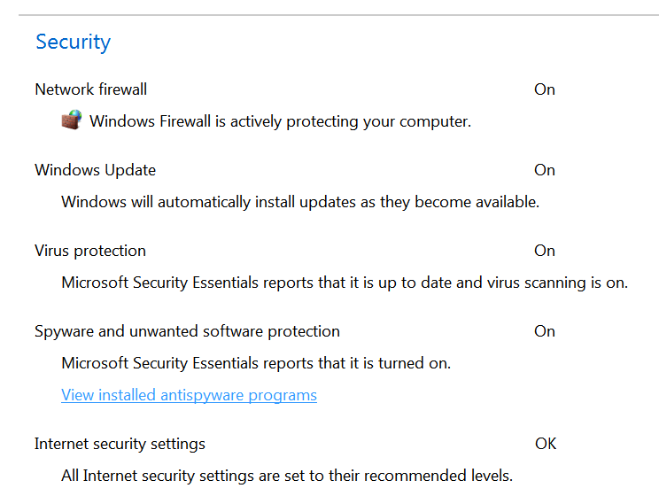
Anti-virus Programs
Windows Security Essentials

Slide 11
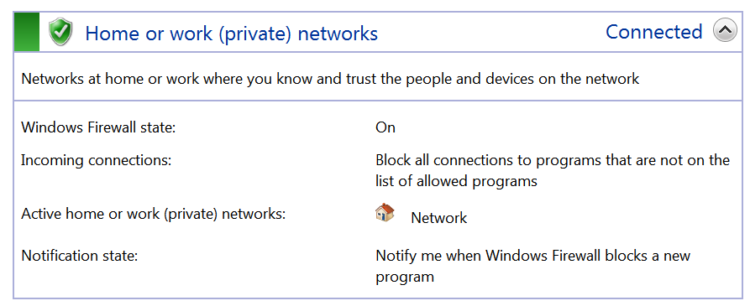
Firewall
A computer firewall limits the data that can pass through it and protects a networked server or client machine from damage by unauthorized users.
Firewalls can be either hardware or software-based.

Slide 12
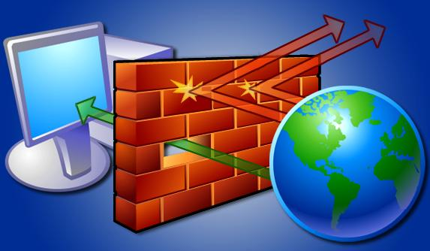
Firewall

Slide 13
User Names and Passwords
User name - Unique combination of characters that identifies user
Password is private combination of characters associated with the user name that allows access to computer resources

Slide 14
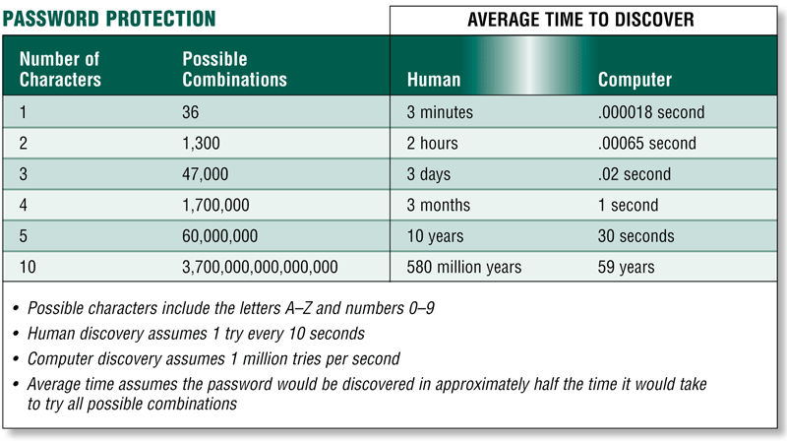
User Names and Passwords

Slide 15
Protecting Your Information from Threats
Keep in mind the following precautions when using computers (both desk top and portable) and other mobile devices:
Use only secure Wi-Fi connections, and disable Wi-Fi and Bluetooth when they are not needed.
Don’t store usernames or passwords attached to a computer or inside its case.
Use a plain case to make a portable computer less conspicuous.
Use a cable lock to secure devices to a desk or other object whenever you must leave them unattended.
Regularly back up your data.

Slide 16
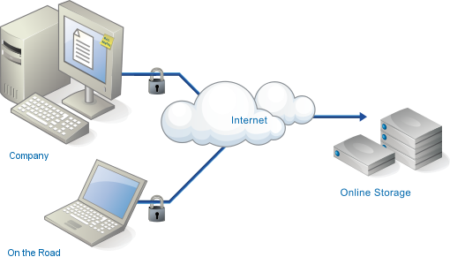
Backing up Your Data
How important is your data?
You can back up on a random basis on to CD/DVD/Blue Ray disks or attached hard drives.
You can automate back up onto internal or external hard drives.
You can use internet back up like cloud storage.

Slide 17
Threats to Computer Hardware
Hardware loss
Hardware theft
Component damage

Slide 18
Threats to Computer Hardware
System failure is the complete malfunction of a computer system.

Slide 19
Systems Failure
Prolonged malfunction of computer
Can cause loss of hardware, software, or data
Caused by aging hardware, natural disasters, malware, or electrical power disturbances
Electric power disturbances
Noise—unwanted electrical signal
Under-voltage—drop in electrical supply
Overvoltage or power surge—significant increase in electrical power

Slide 20
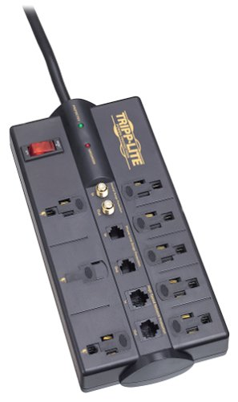
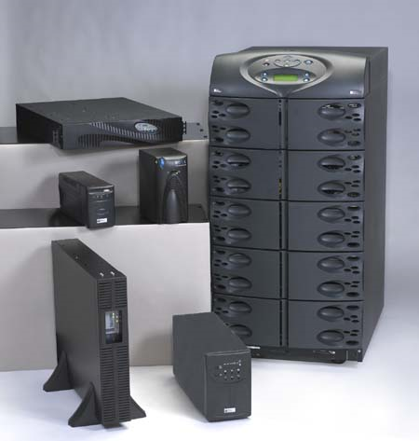
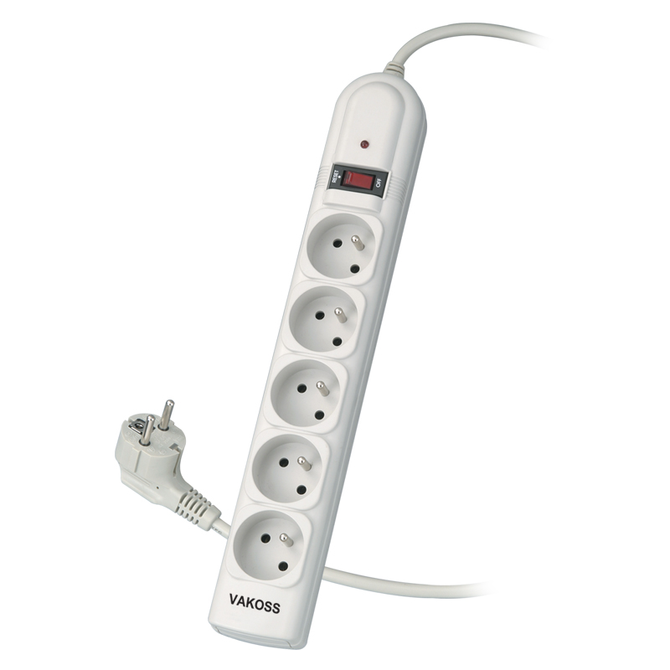
Power Protection
Surge protector – protects equipment from noise and over voltage
Uninterruptible power supply (UPS) - protects equipment from noise and over voltage and under voltage.

Slide 21
Hardware Care
Proper care of hardware can help prevent serious damage to a computer system:
Protective cases
Ruggedized devices

Slide 22
Understanding Privacy Concerns
Privacy is usually defined as the state of being concealed or free from unauthorized intrusion.
The term information privacy refers to the rights of individuals and companies to control how information about them is collected and used.

Slide 23
Databases, Electronic Profiling, Spam, and Other Marketing Activities
Marketing databases contain marketing and demographic data about people, such as where they live and what products they buy.
Information about individuals is also available in government databases.
Collecting in-depth information about an individual is known as electronic profiling.

Slide 24
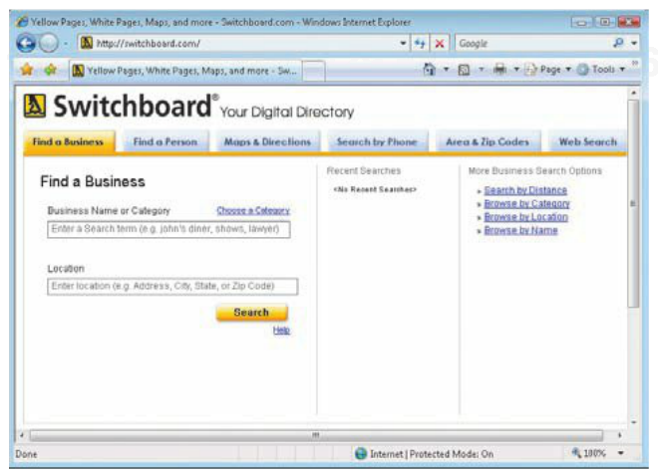
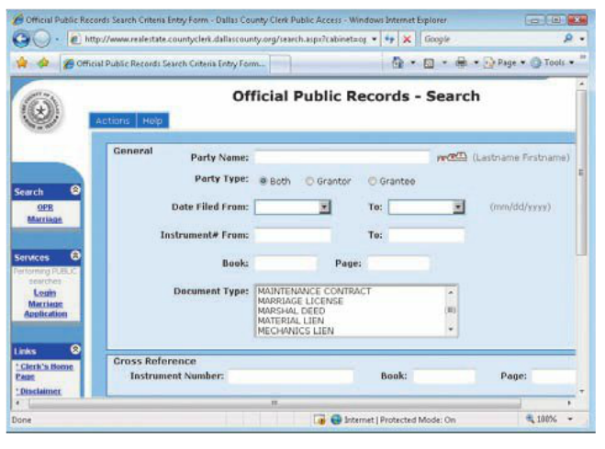
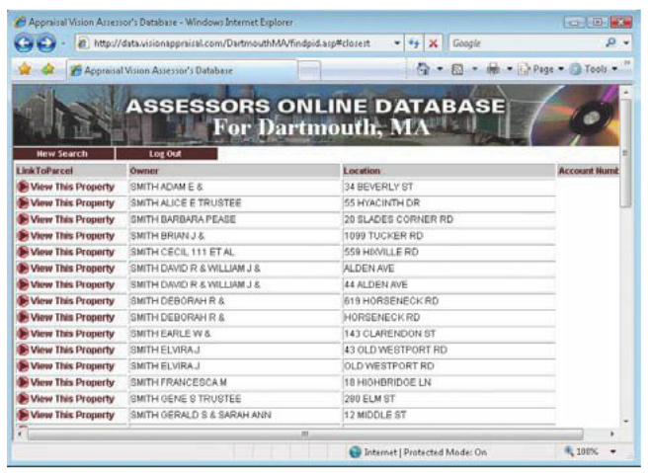
Databases, Electronic Profiling, Spam, and Other Marketing Activities
Database examples;
Property value
Public records
Address

Slide 25
Databases, Electronic Profiling, Spam, and Other Marketing Activities
Most businesses and Web sites that collect personal information have a privacy policy that discloses how the personal information you provide will be used.
Amazon.com
Information You Give Us: We receive and store any information you enter on our Web site or give us in any other wayYou can choose not to provide certain information, but then you might not be able to take advantage of many of our features. We use the information that you provide for such purposes as responding to your requests, customizing future shopping for you, improving our stores, and communicating with you.
Our site includes third-party advertising and links to other Web sites. We do not provide any personally identifiable customer information to these advertisers or third-party Web sites.

Slide 26
Electronic Surveillance and Monitoring
Computer monitoring software: records keystrokes, log the programs or Web sites accessed, or otherwise monitors someone’s computer activity.
Video surveillance: the use of video cameras to monitor activities of individuals for work-related or crime-preventions purposes.
Employee monitoring: recording or observing the actions of employees while on the job.
Presence technology: enables one computing device to locate and identify the current status of another device on the same network.

Slide 27
Protecting Personal and Workplace Privacy
There are not many options for protecting yourself against computer monitoring by your employer or the government, or against video surveillance systems.
Businesses should take the necessary security measures to ensure that employee activities are not being monitored by a hacker or other unauthorized individual.
It is illegal for one individual to monitor the activities on another individual.

Slide 28
Network and Internet Security Legislation
It’s difficult for the legal system to keep pace with the rate at which technology changes.
The high level of concern regarding computer security and personal privacy has led state and federal legislators to pass a variety of laws since the 1970s.

